Slide 1
Diafiltration Experiments Elucidate Multi-body Interactions in Complex Feed Streams
Group Meeting – 7/25/24
Target Journal: Nature – Chemical Engineering, Science

Slide 2
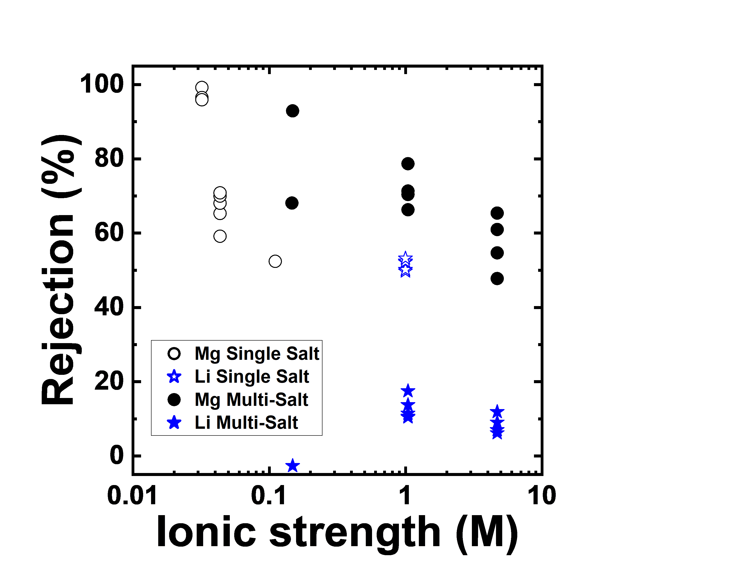
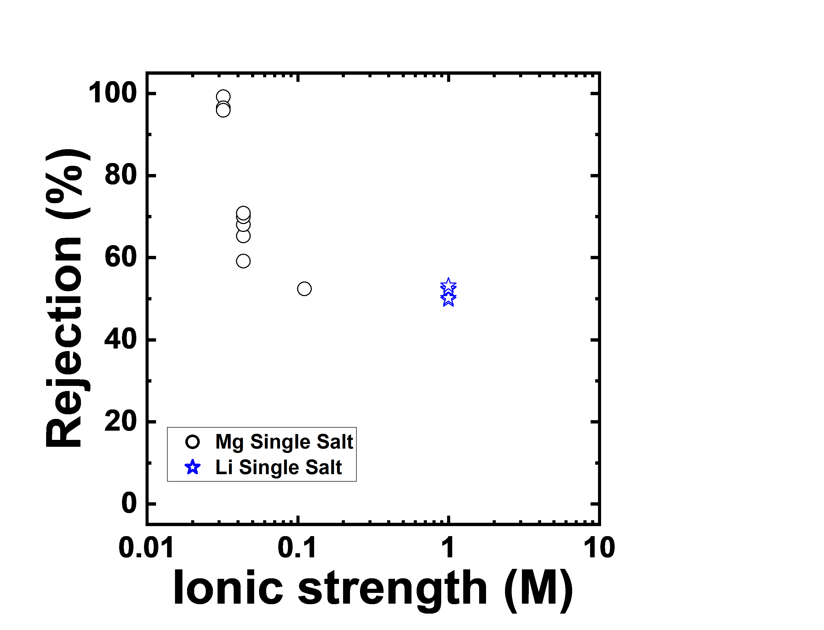
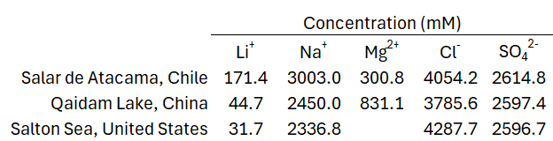
Multicomponent Feeds Effect Membrane Performance
How can we use diafiltration experiments to systematically explore the effect of multicomponent feeds on membrane performance?
2
Notes:
Change plot to be the amount of solution that permeated.
Concentrating Regime – Diafiltrate: 5 mM KCl
Critical Regime – Diafiltrate: 1.5 mM KCl (black), 1.8 mM KCl (red)
Diluting Regime – Diafiltrate: 0 mM KCl

Slide 3
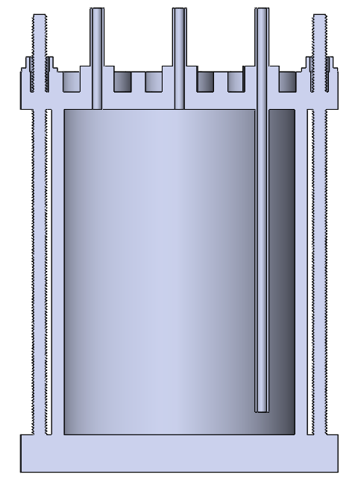
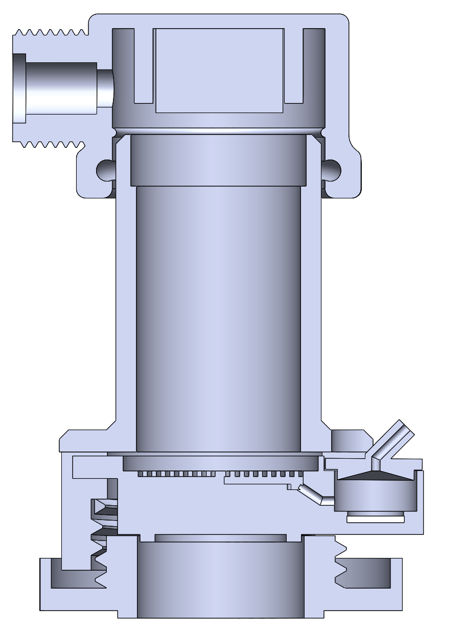
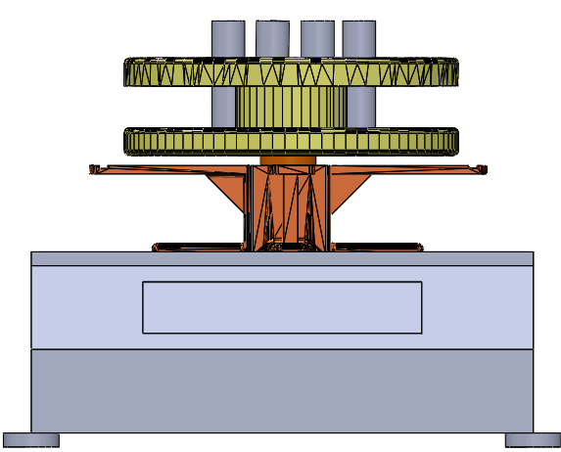

Diafiltration Experiments are Run in a Modified Stirred Cell Apparatus.
Pressure Relief Valve
P
Pressure Gauge
Stirred Cell
Scintillation Vials
Diafiltrate Tank
Permeate Outlet
Motor
Retentate Probe
Balance
Membrane
Permeate Probe
Multiple (two) salts are now placed within the feed and diafiltrate reservoirs.
Retentate and permeate conductivity data are obtained at 5 second intervals.
Scintillation vials are analyzed after the experiment (ICP-OES) to get ion specific concentrations.
Running Experiments | Raw Data Analysis |

Slide 4
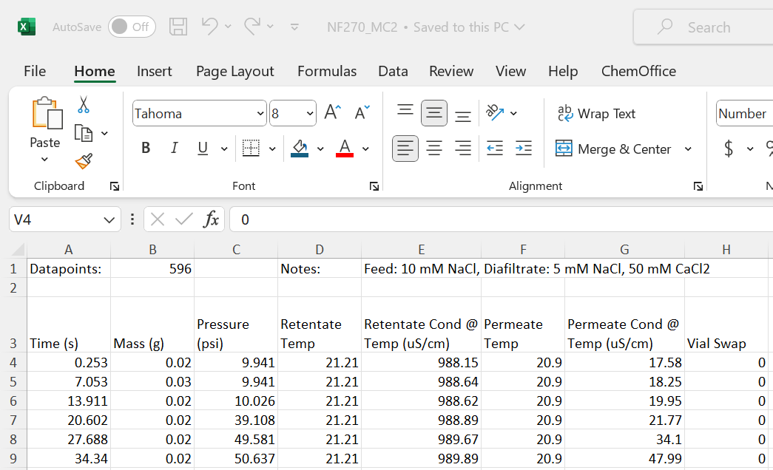
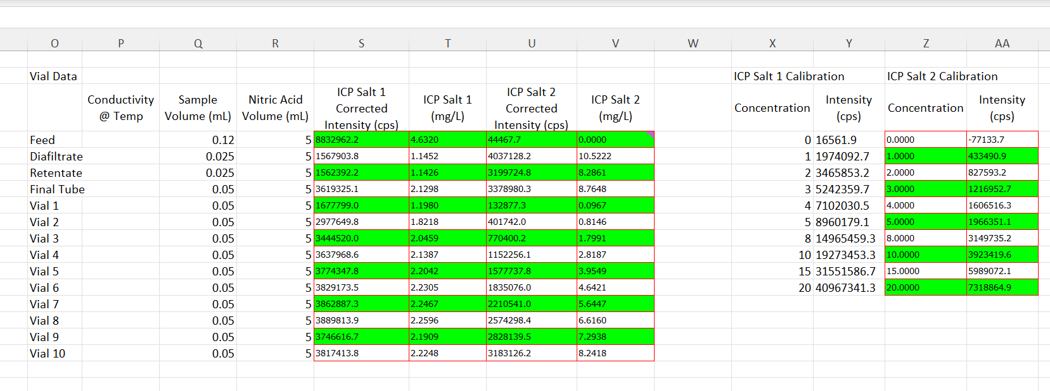
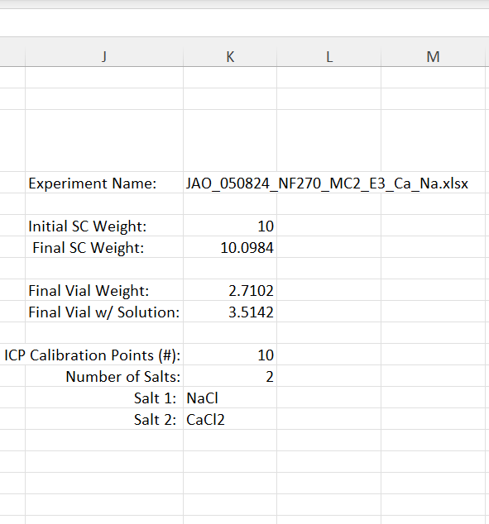
RAW Excel Data will be Included in the Supplementary Information.
Comment/Question on Error: The error associated with the calibration curve is larger than the error associated with the device making the measurement. In the following slides, the analyses incorporate the error of the calibration curve. Error propagation is left for future discussion.

Slide 5
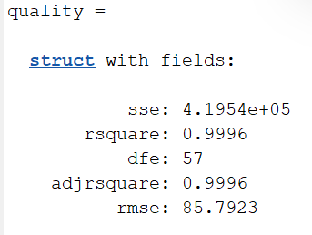
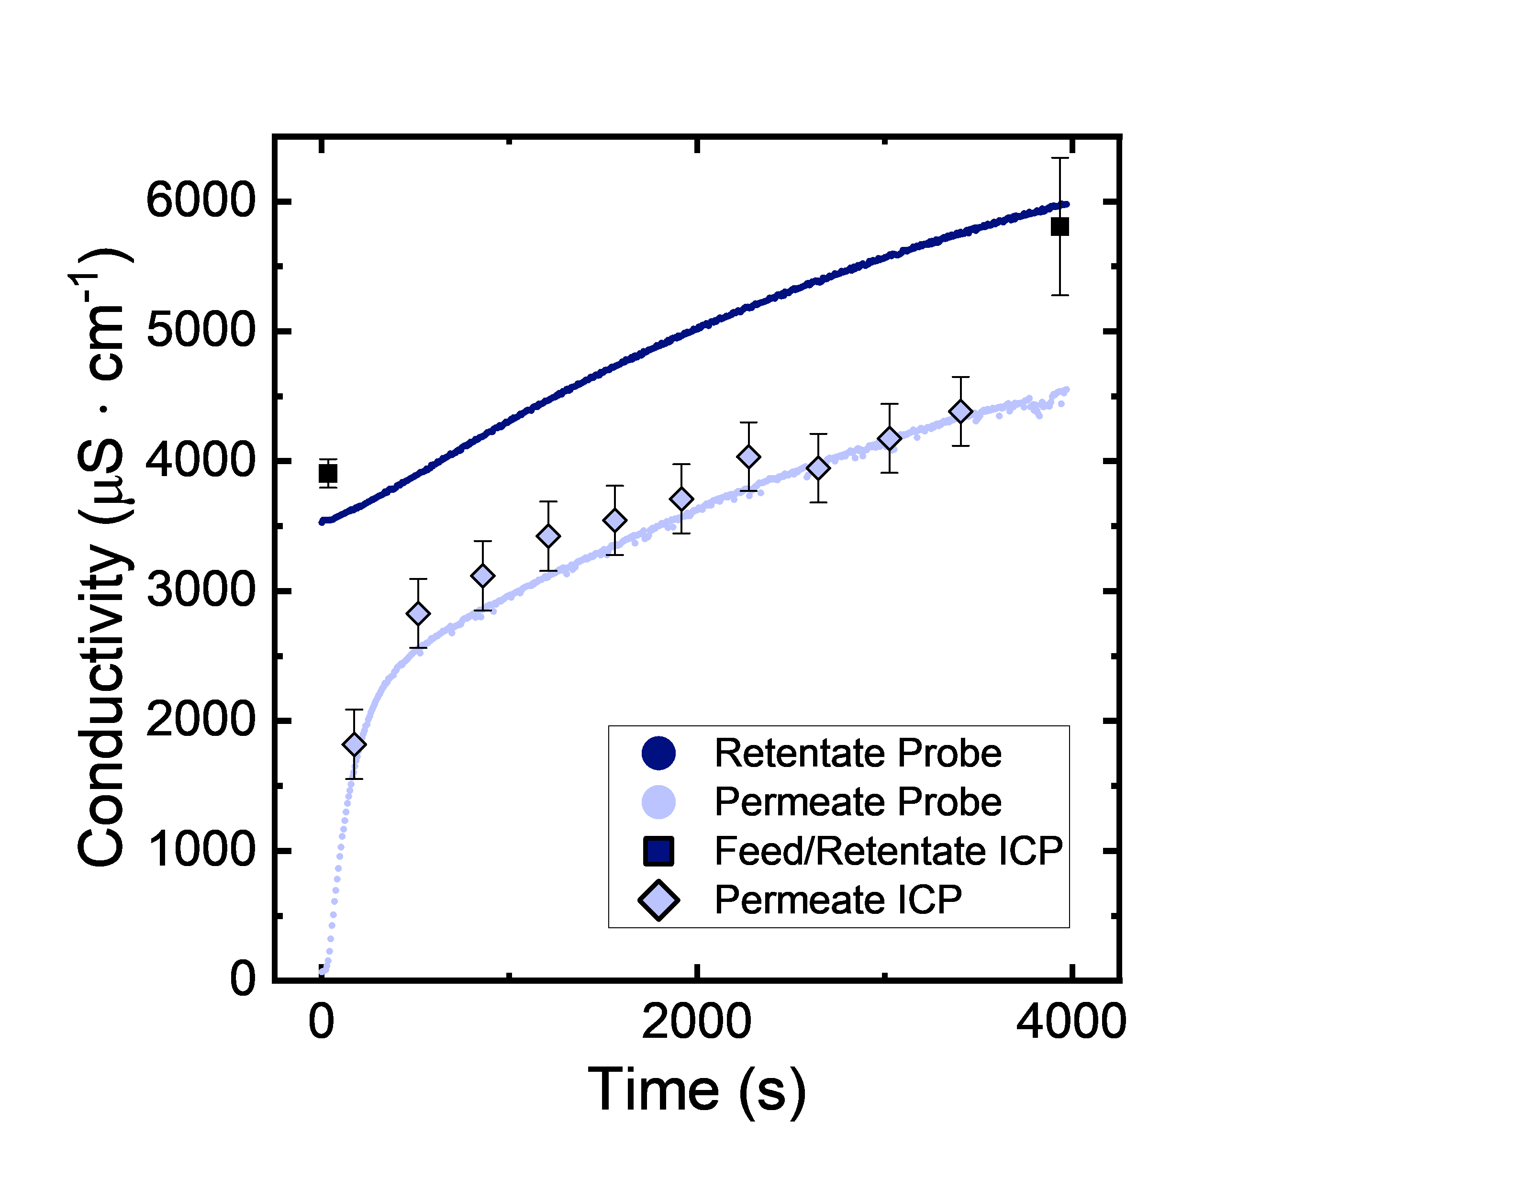
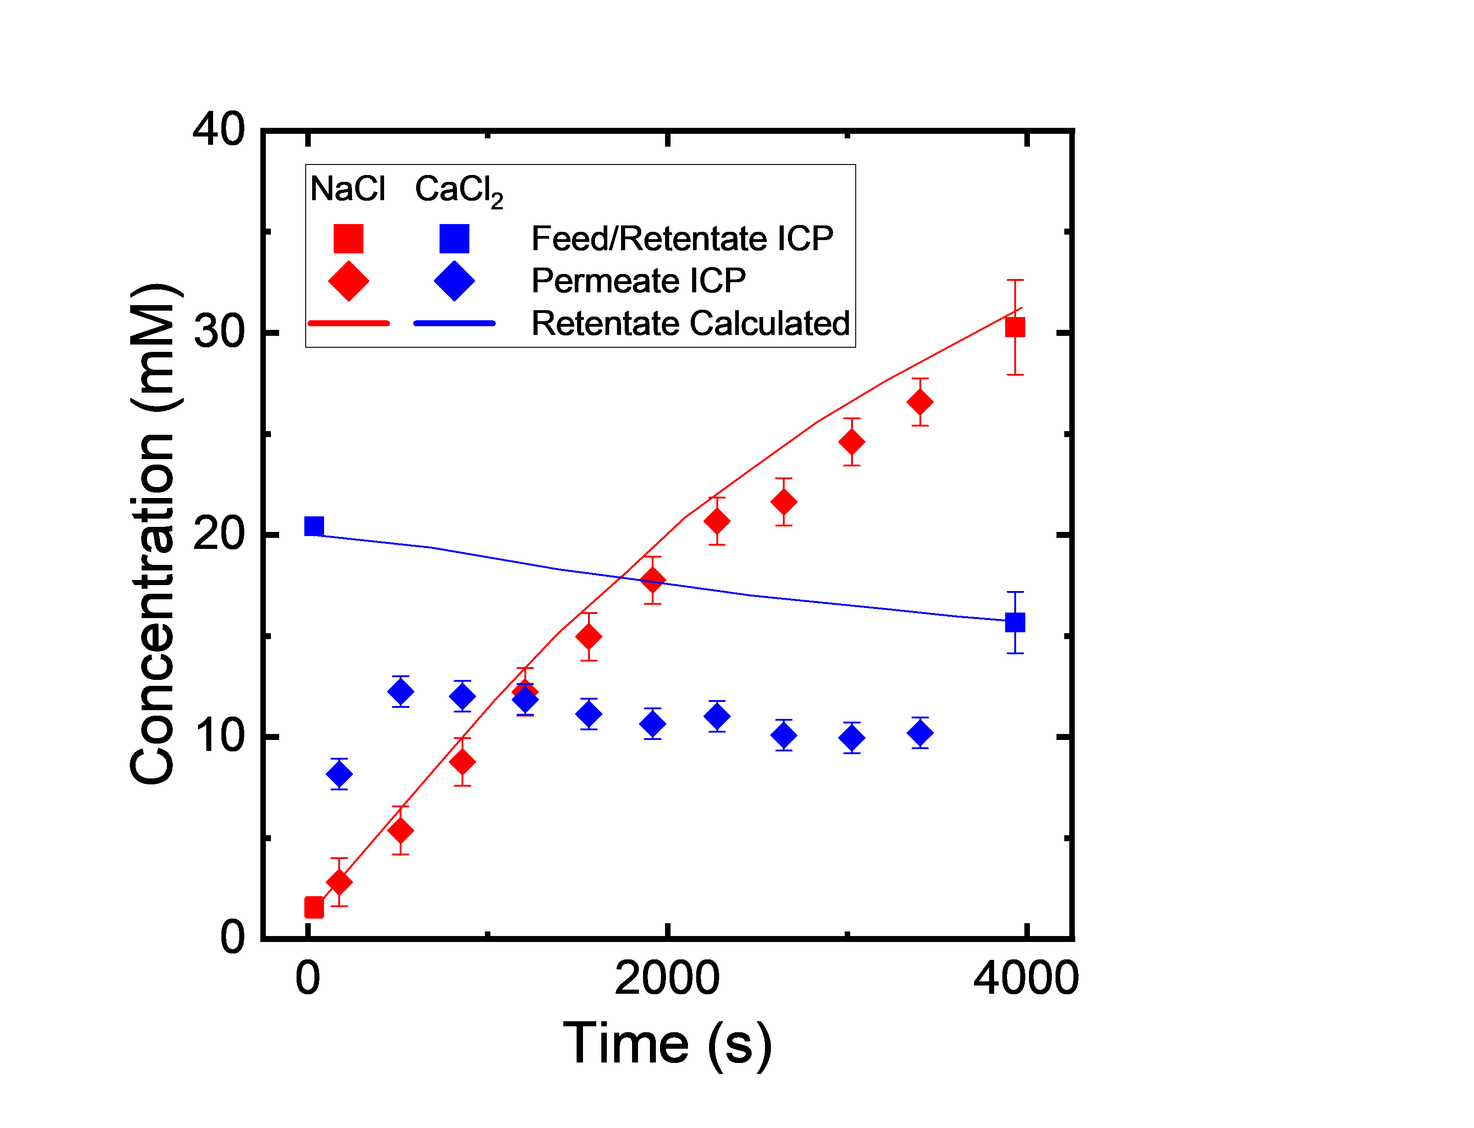
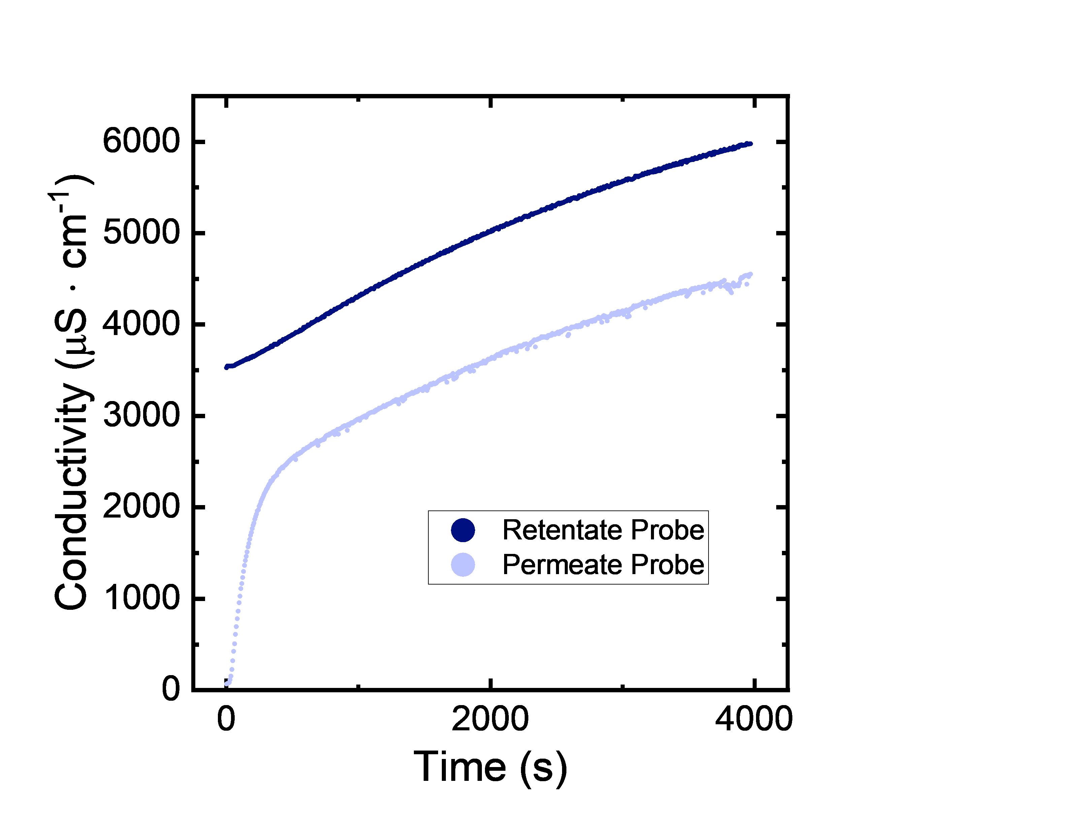
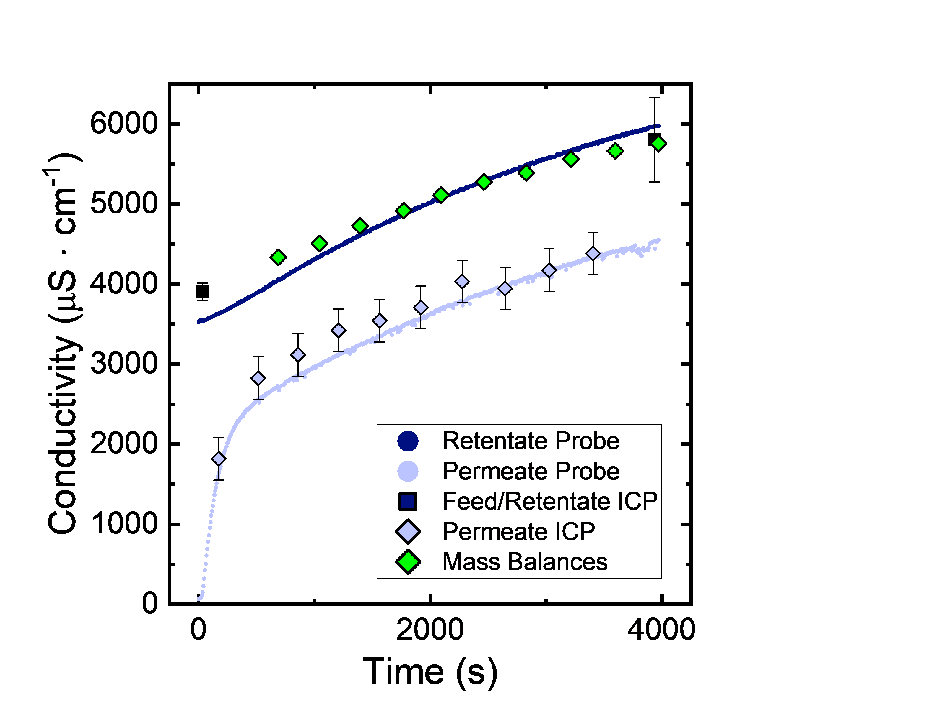
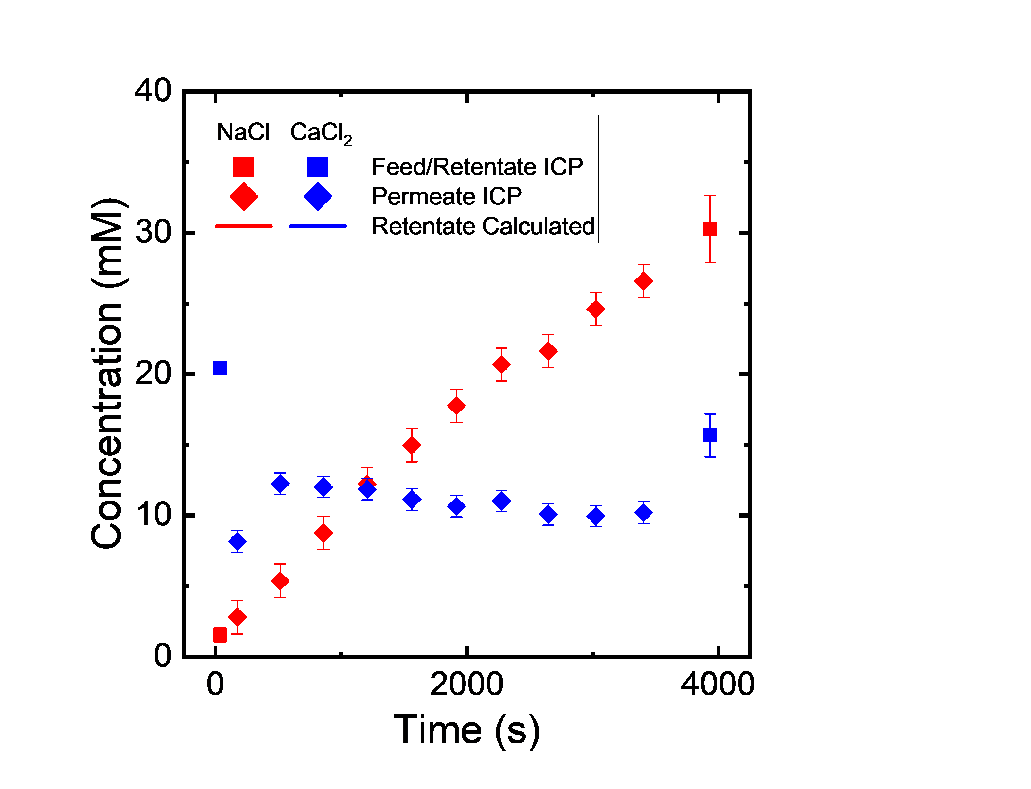
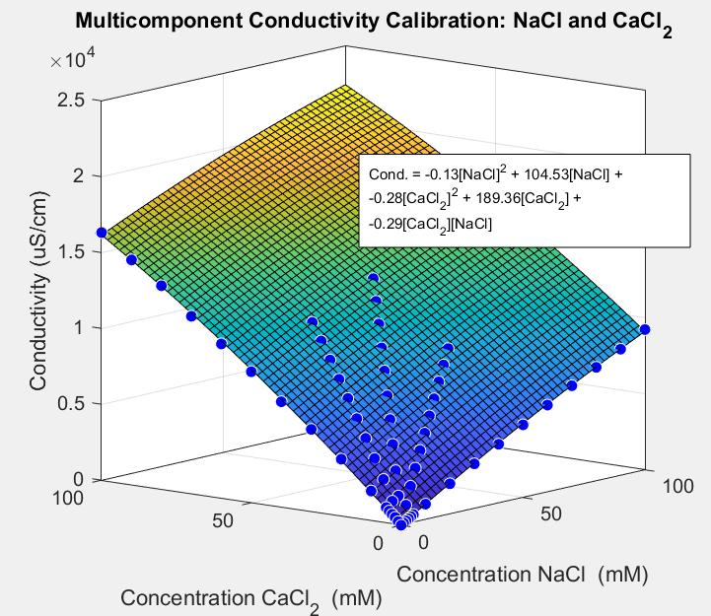
Raw Data Analysis and Visualization
Feed: 20 mM NaCl
Diafiltrate: 10 mM NaCl, 50 mM CaCl₂
The conductivity measurements and ICP data (including mass balances) ensures the data is self consistent.

Slide 6
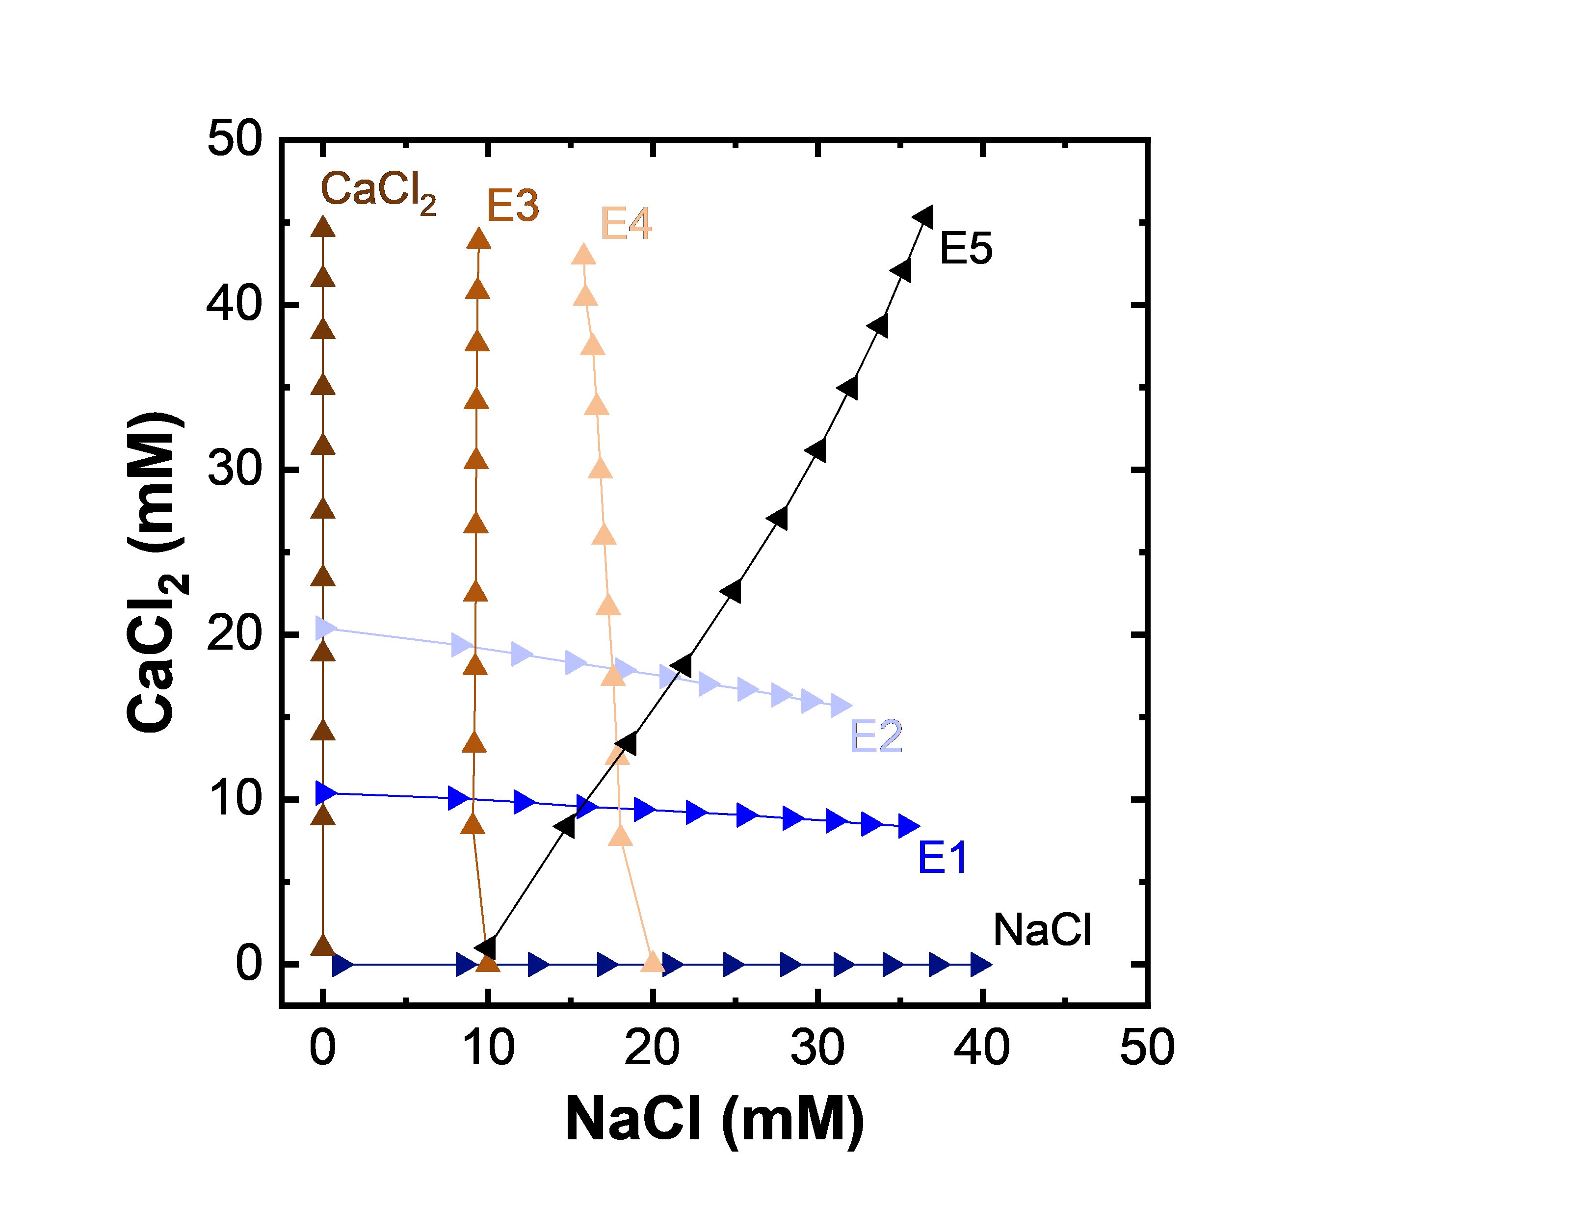
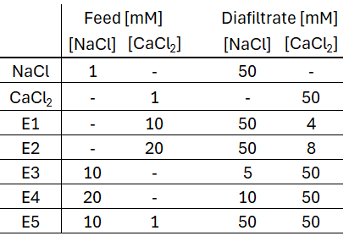
Diafiltration Experiments Systematically Explore Multi-component Feeds
The data plots the retentate concentrations that were explored throughout the course of the experiments.
Is the performance of a membrane dependent on the ‘prior’ conditions?
How can we begin to model the flux of solutions through NF270 membranes?

Slide 7
Do the Previous Experimental Conditions Effect Subsequent Measurements?
What data is relevant? How do we process the raw data?
Concentrating Experiments
1 mM CaCl₂ Feed
50 mM Diafiltrate
Diluting Experiments
50 mM CaCl₂ Feed
0 mM Diafiltrate

Slide 8
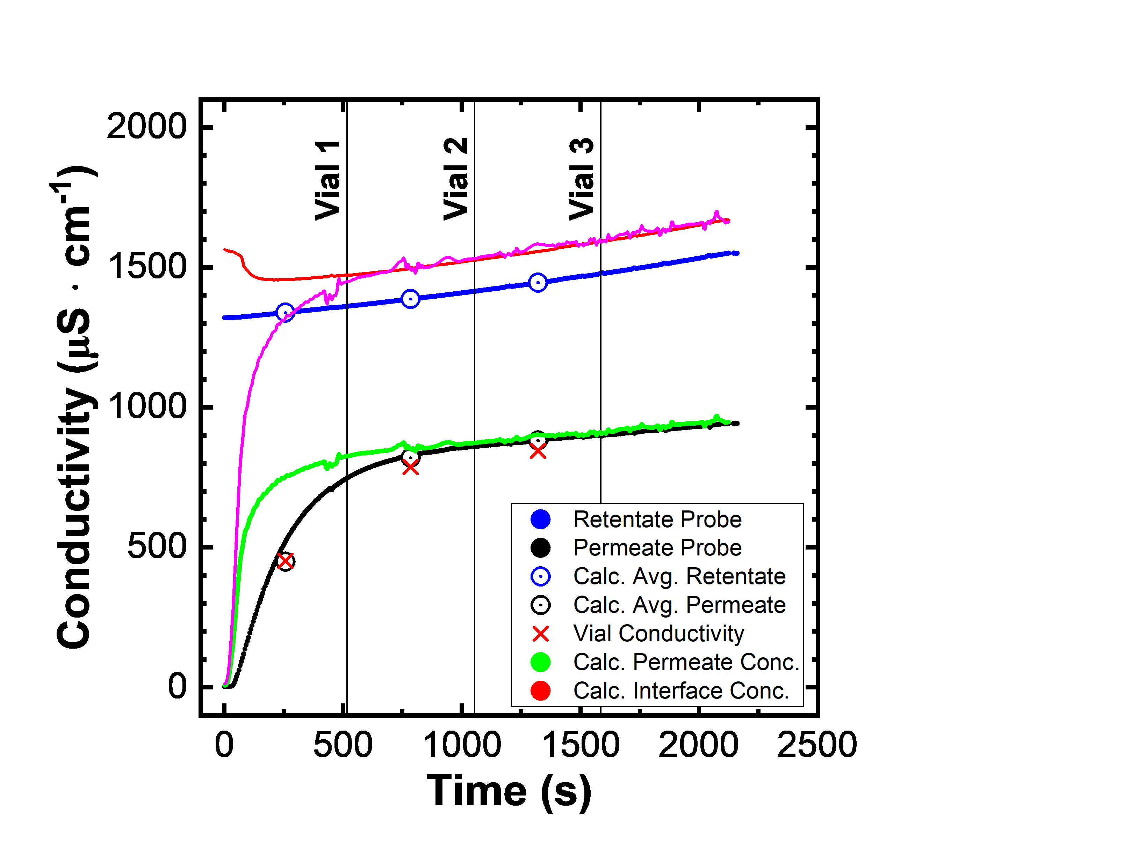
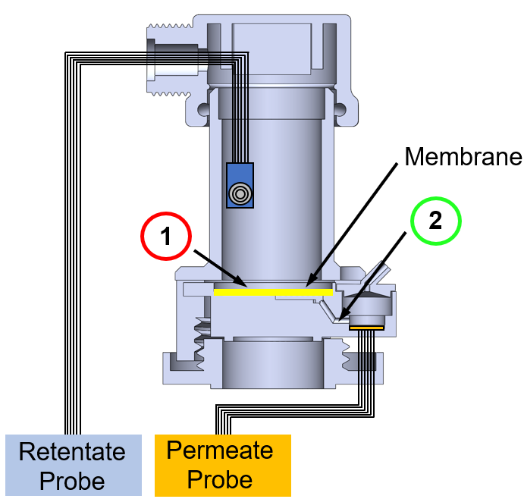
Filtration Experiments Educate Data Processing.
Obtain concentrations related to the driving forces. (i.e., position #1 and #2)
Remove data associated with the residence time of the permeate reservoir.

Slide 9
Data Processing Helps, But is not the Solution.
Next Steps
Look more closely at Jw.
Look more closely at experiments conducted before.
Currently – Membranes are washed with 3 mL of water.
Is this enough to remove adsorbed ions?
Possibility: Ions from previous experiment are displaced/removed from the membrane and artificially increase the permeate concentration. (not sufficient to explain trends because ICP matches conductivity within error, that would be a lot of ions coming off the membrane)

Slide 10
Sieving coefficient is dependent on water flux.
NaCl
CaCl2

Slide 11
Programming to develop DAEs.

Slide 12
Diafiltration Experiments Systematically Explore Multi-component Feeds
The data plots the retentate concentrations that were explored throughout the course of the experiments.
Is the performance of a membrane dependent on the ‘prior’ conditions?
How can we begin to model the flux of solutions through NF270 membranes?

Slide 13
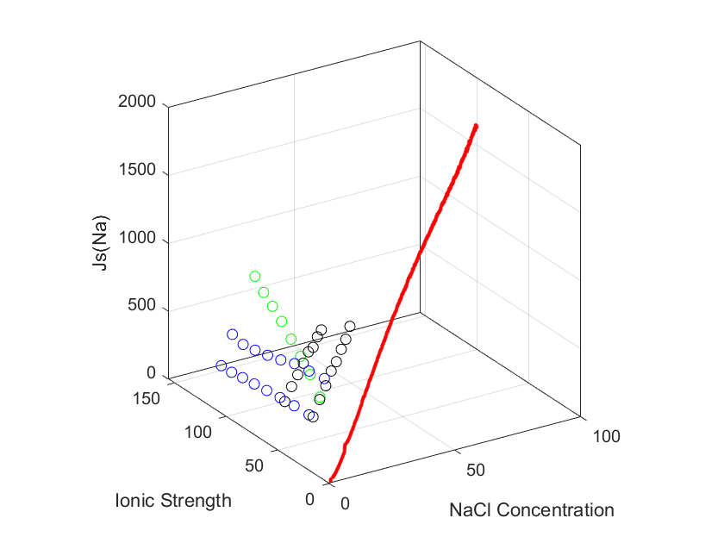
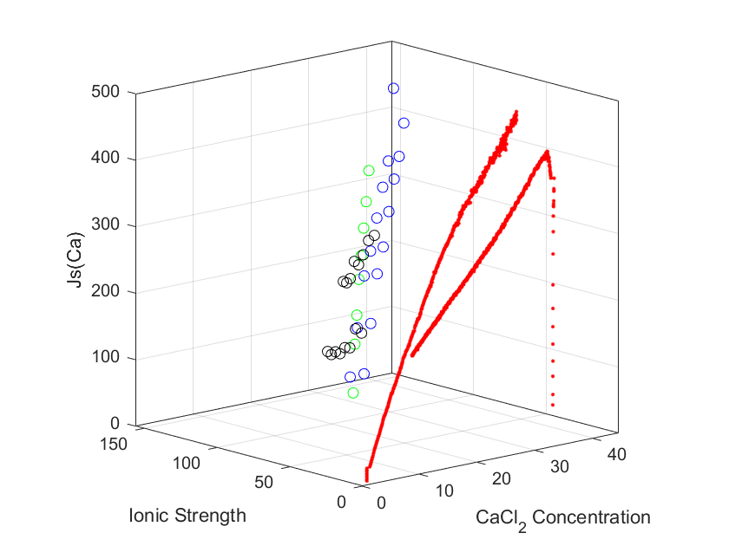
$J_{s}^{i}=J_{w}c_{p}^{i}$ Captures the Flux of each Ion through the Membrane

Slide 14
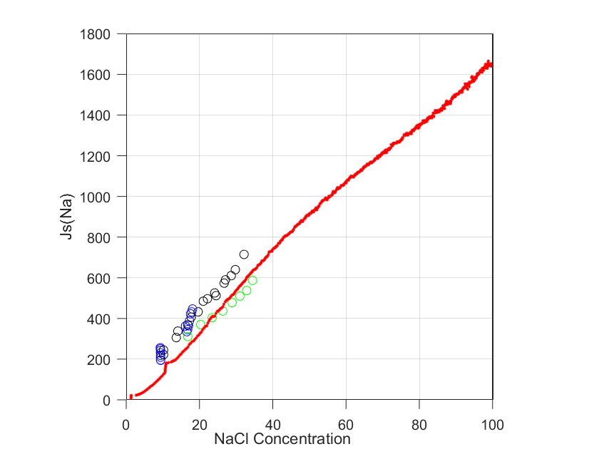
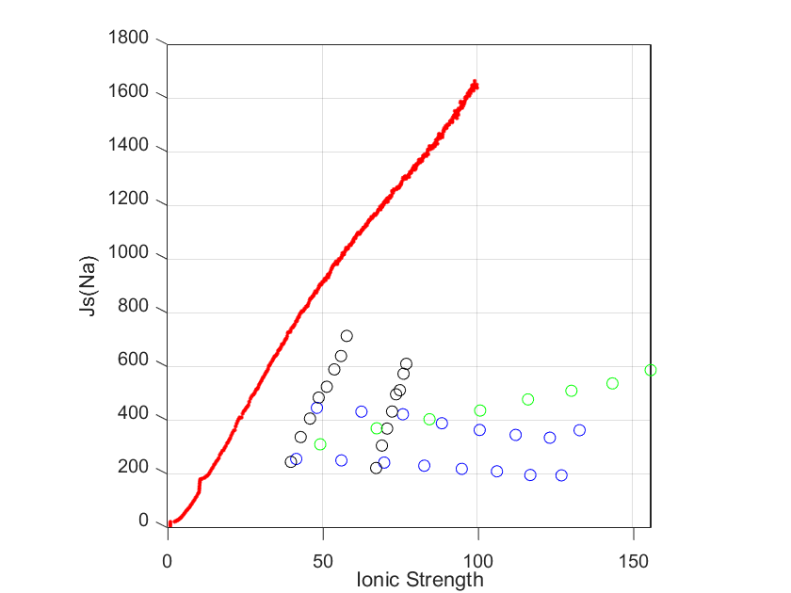
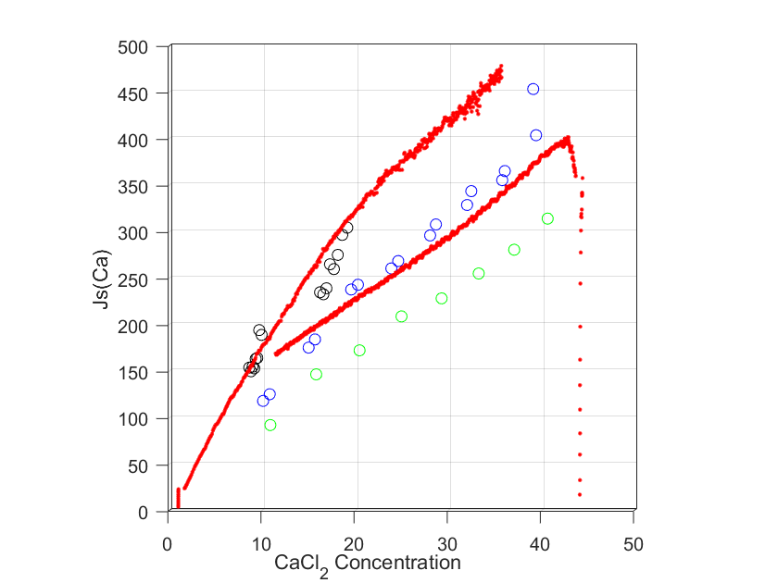
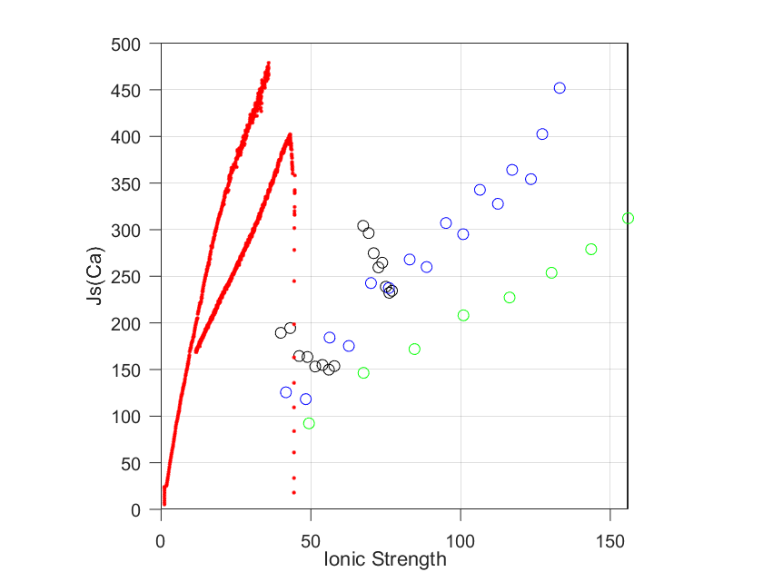
$J_{s}^{i}=J_{w}c_{p}^{i}$ Captures the Flux of each Ion through the Membrane
Generally, in the presence of other ions: $J_{s}^{Na}$ increases and $J_{s}^{Ca}$ decreases.

Slide 15



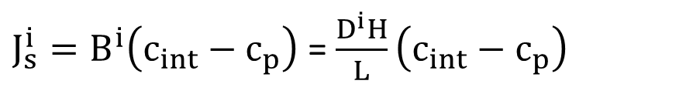
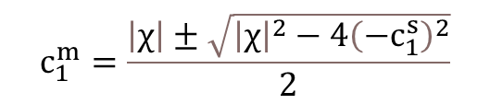



Donnan Model Provides Information on Ion Partitioning in Charged Membranes
$J_{s}^{i}=B^{i}\left(c_{int}−c_{p}\right)$ = $\frac{D^{i}H}{L}\left(c_{int}−c_{p}\right)$
$$\left|z_{1}\right|c_{1}^{m}+\left|z_{2}\right|c_{2}^{m}=\left|χ\right|+\left|z_{3}\right|c_{3}^{m}$$
$$μ_{i}^{m}=μ_{i}^{s}$$
Electroneutrality Constraint
$$\left|z_{1}\right|c_{1}^{s}+\left|z_{2}\right|c_{2}^{s}=\left|z_{3}\right|c_{3}^{s}$$
$${\left(c_{1}^{s}\right)}^{\frac{1}{\left|z_{1}\right|}}{\left(\left|\frac{z_{1}}{z_{3}}\right|c_{1}^{s}+\left|\frac{z_{2}}{z_{3}}\right|c_{2}^{s}\right)}^{\frac{1}{\left|z_{3}\right|}}={\left(c_{1}^{m}\right)}^{\frac{1}{\left|z_{1}\right|}}{\left(\left|\frac{z_{1}}{z_{3}}\right|c_{1}^{m}+\left|\frac{z_{2}}{z_{3}}\right|c_{2}^{s}{\left(\frac{c_{1}^{m}}{c_{1}^{s}}\right)}^{\left|\frac{z_{2}}{z_{1}}\right|}−\frac{\left|χ\right|}{\left|z_{3}\right|}\right)}^{\frac{1}{\left|z_{3}\right|}}$$
$${\left(c_{2}^{s}\right)}^{\frac{1}{\left|z_{2}\right|}}{\left(\left|\frac{z_{1}}{z_{3}}\right|c_{1}^{s}+\left|\frac{z_{2}}{z_{3}}\right|c_{2}^{s}\right)}^{\frac{1}{\left|z_{3}\right|}}={\left(c_{2}^{m}\right)}^{\frac{1}{\left|z_{2}\right|}}{\left(\left|\frac{z_{1}}{z_{3}}\right|c_{1}^{s}{\left(\frac{c_{2}^{m}}{c_{2}^{s}}\right)}^{\left|\frac{z_{1}}{z_{2}}\right|}+\left|\frac{z_{2}}{z_{3}}\right|c_{2}^{m}−\frac{\left|χ\right|}{\left|z_{3}\right|}\right)}^{\frac{1}{\left|z_{3}\right|}}$$
$${{\left(c_{3}^{s}\right)}^{\frac{1}{\left|z_{3}\right|}}\left(\left|\frac{z_{3}}{z_{2}}\right|c_{3}^{s}−\left|\frac{z_{1}}{z_{2}}\right|c_{1}^{s}\right)}^{\frac{1}{\left|z_{2}\right|}}={{\left(c_{3}^{m}\right)}^{\frac{1}{\left|z_{3}\right|}}\left(\frac{\left|χ\right|}{\left|z_{2}\right|}+\left|\frac{z_{3}}{z_{2}}\right|c_{3}^{m}−\left|\frac{z_{1}}{z_{2}}\right|c_{1}^{s}{\left(\frac{c_{3}^{s}}{c_{3}^{m}}\right)}^{\frac{z_{1}}{z_{3}}}\right)}^{\frac{1}{\left|z_{2}\right|}}$$
$$c_{1}^{m}=\frac{\left|χ\right|±\sqrt{{\left|χ\right|}^{2}−4{\left(−c_{1}^{s}\right)}^{2}}}{2}$$
If it is a one salt system… It simplifies.
$${\left(c_{1}^{m}\right)}^{2}−\left|χ\right|c_{1}^{m}−{\left(c_{1}^{s}\right)}^{2}=0$$

Slide 16
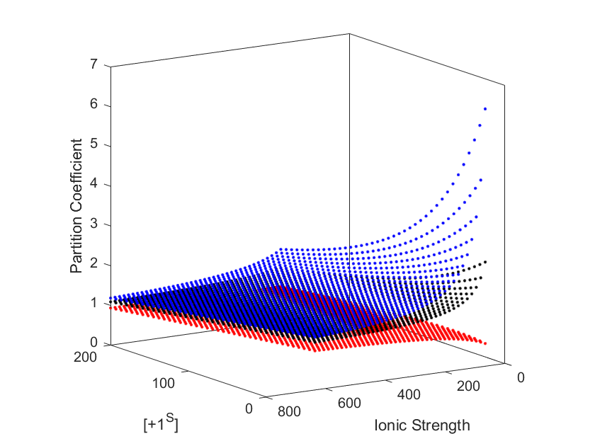
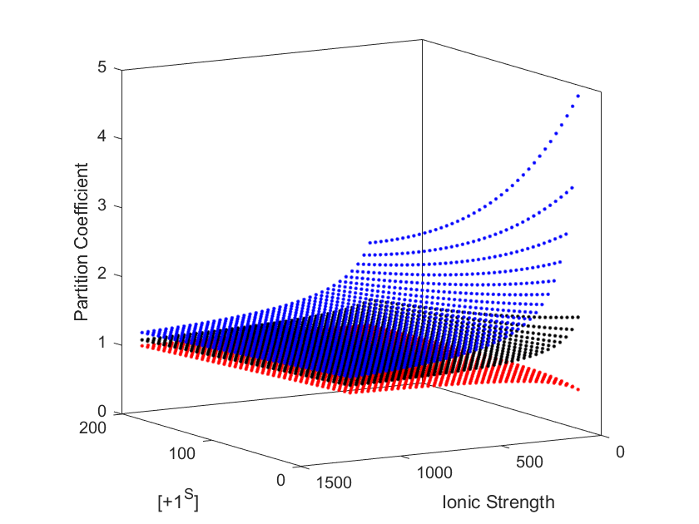
The Counter Ion with the Higher Valence has a Larger Partition Coefficient
Representative of a NaCl/CaCl₂ System
Representative of a NaCl/LaCl₃ System
Specie 1: +1
Specie 2: +2
Specie 3: -1
Specie 1: +1
Specie 2: +3
Specie 3: -1
We could conduct isotherms (i.e., measure the partitioning of 3 specie systems) to show that Donnan, is not the only governing phenomena.
Can we incorporate steric hinderance to come closer to the “true” partitioning values for the ions?
Notes:
Dominant salt – Are there additional experiments that we want to run that conform to these different limits in which one of the ions is a trace.

Slide 17
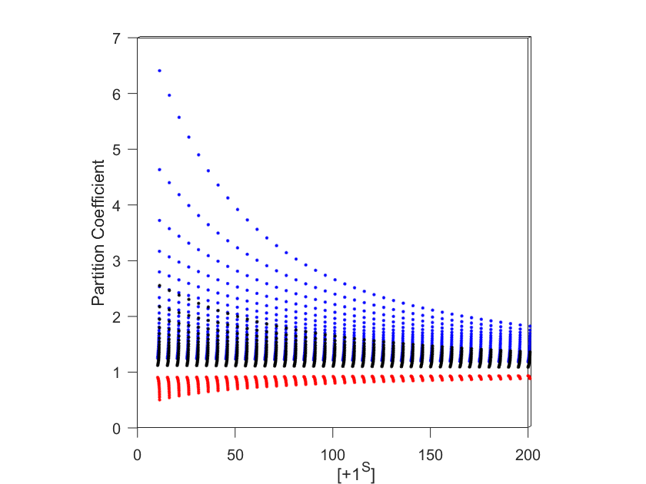
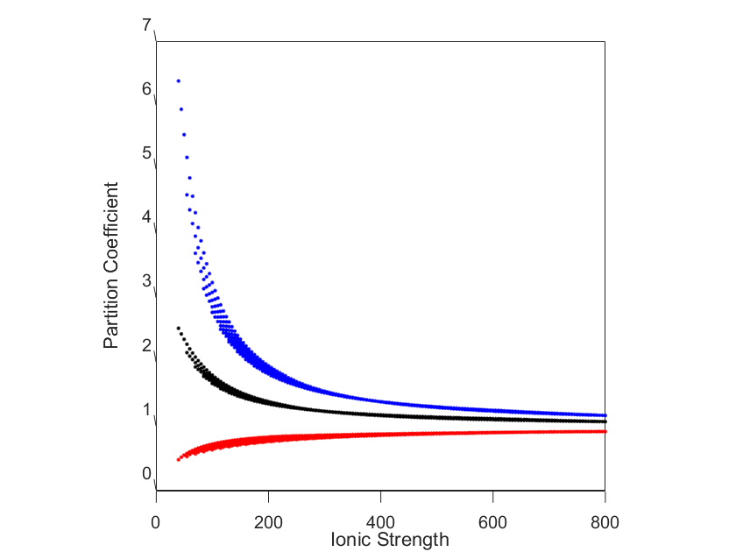
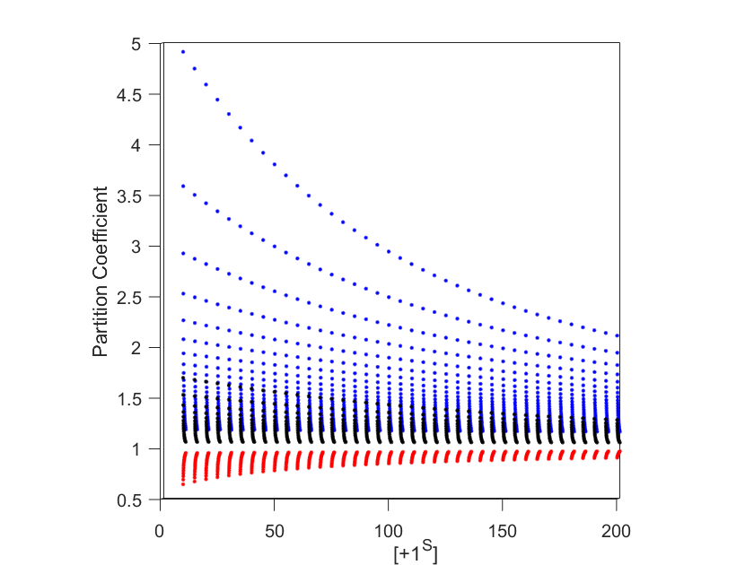
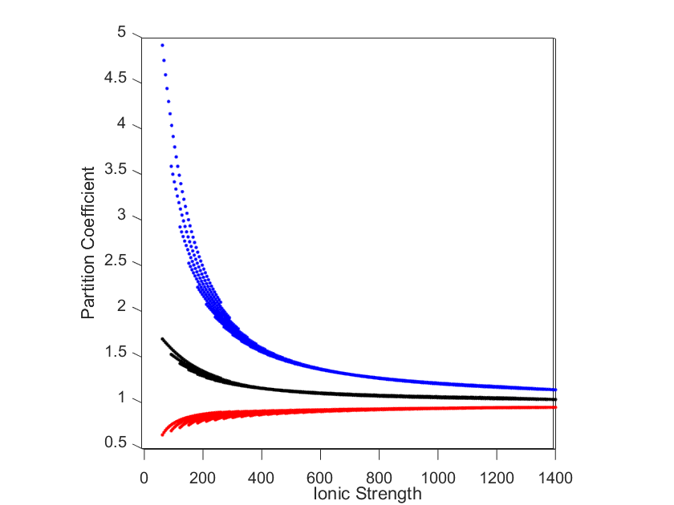
Representative of a NaCl/CaCl₂ System
Specie 1: +1
Specie 2: +2
Specie 3: -1
Representative of a NaCl/LaCl₃ System
Specie 1: +1
Specie 2: +3
Specie 3: -1
Notes:
Dominant salt – Are there additional experiments that we want to run that conform to these different limits in which one of the ions is a trace.

Slide 18
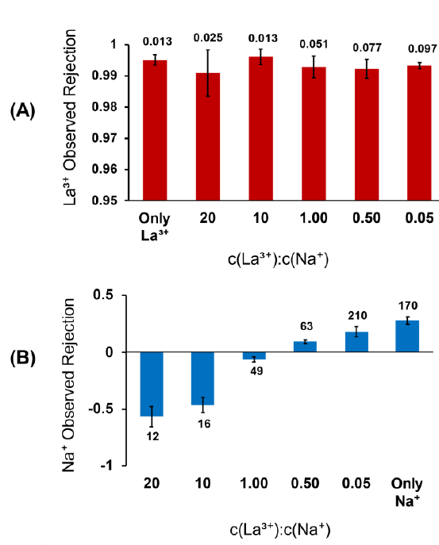
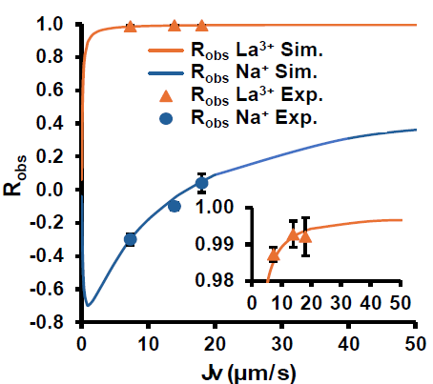
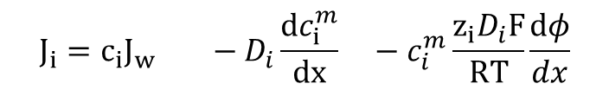
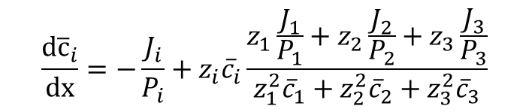

The Solution-Diffusion-Electromigration Model may Accounts for some of the Observed Rejections.
Unpublished data from Jun Wang (Bruening Lab)
Cross validate data with ours.
Use her model to determine the fit with our data.
$$J_{i}=−P_{i}\left(\frac{d{\overline{c}}_{i}}{dx}+{\overline{c}}_{i}\frac{z_{i}F}{RT}\frac{dφ}{dx}\right)$$
$$\frac{d{\overline{c}}_{i}}{dx}=−\frac{J_{i}}{P_{i}}+z_{i}{\overline{c}}_{i}\frac{z_{1}\frac{J_{1}}{P_{1}}+z_{2}\frac{J_{2}}{P_{2}}+z_{3}\frac{J_{3}}{P_{3}}}{z_{1}^{2}{\overline{c}}_{1}+z_{2}^{2}{\overline{c}}_{2}+z_{3}^{2}{\overline{c}}_{3}}$$
This model does not account for convection through the membrane. Several experiments conducted at different pressures suggest that convection will be important.
$$J_{i}=c_{i}J_{w} −D_{i}\frac{dc_{i}^{m}}{dx} −c_{i}^{m}\frac{z_{i}D_{i}F}{RT}\frac{dφ}{dx}$$
Convection
Diffusion
Electromigration
Notes:
Dominant salt – Are there additional experiments that we want to run that conform to these different limits in which one of the ions is a trace.

Slide 19
Questions?

